Slide 1

Bradley Training and Assessment Course
(BTAC)
Student Read Ahead

Slide 2

















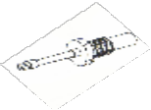




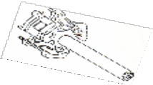

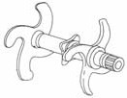
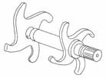


1.0 HP, 24 Vdc Motor Assembly
Small Bevel Gear
Large Bevel Gear
Clutch Assembly
Spur Gear Cluster
Spur Assembly Gear
Straight Drive Shaft
Drive Sprocket (Track Assembly)
(Receiver Assembly)
Worm Shaft Assembly
(contains the gear for Manual drive, driven
By the Manual gear hub)
Worm Wheel Gear
Clutch Spur Gear (large gear)
Spur Gear shaft (Small Gear)
Upper Spur Gear
Gear Clutch Assembly
Index Drive Shaft
(contains a notch to hold Index Drive
Gears in precise alignment) Cam
Timing Cams
Control Cam
Lower Spur Gear
When Engaged
(Always)
Bolt Position Indicator
Lower Sliding Sleeve Clutch
Upper Sliding Sleeve Clutch
Rotor Stub
Lower Shouldered Shaft
Upper Shouldered Shaft
Lower Feed Shaft Stop Assembly
Lower Feed Sprocket Assembly
Upper Feed Shaft Stop Assembly
Feeder Assembly Rotor
Upper Feed Sprocket Assembly
Clutch Yoke Assembly
Actuator
Electrical Feed Select Solenoid
E-1

Slide 3
(
(
)
)
(
)
( )
(
)
(
)
(
)
E-1

Slide 4
VERBATIM NOTE CARDS

Slide 5
Forward Feed Section Subcomponents (Verbatim)
Round Positioner Assembly
Upper Feed Sprocket assembly
Feeder Assembly Rotor
Forward Feed Assembly
Lower Feed Sprocket Assembly
Ejection Chute

Slide 6
Receiver Assembly Subassemblies
(Verbatim)
Barrel support assembly
Recoil mechanism
Breech assembly
Sear assembly
Sear catch assembly
Sear retractor assembly
Mechanical safety interlock system
1.0 HP 24 VDC Motor assembly
Handle Pin
Electrical Sear Solenoid
Riveted Receiver assembly

Slide 7
Firing Pin Assembly
(Verbatim)
Fall is 0.56 inch (14.2 mm)
Protrudes through Bolt Face: 1.5mm to 2.5 mm
Firing pin strikes a M115 Percussion Primer
Delivers 32 inch-lbs
Requires 19 inch-lbs
Safety margin 13 inch-lbs

Slide 8
25-mm Equipment Data
(Verbatim)
Time to rate: 0.15 sec, The delay from the time the gun receives the signal to start until mechanical actions begin to start.
Time to stop: 0.12 sec, The delay from the time the gun receives the signal to stop until mechanical actions begin to stop.

Slide 9
25-mm Equipment Data
(Verbatim)
Power required: 1.0 HP 24 Vdc motor assembly
Voltage to Operate M242 Electrical System
Required: 18-28 VDC
Provided: 18-30 VDC
Average Used: 24 VDC
Safety Margin: 2 VDC
Rated at 28 VDC

Slide 10
25-mm Equipment Data
(Verbatim)
Open Bolt Clearing Method: Cook-off safe
Absolute Hang-Fire Protection: Mechanical Safety Interlock System (MSIS)

Slide 11
25-mm Equipment Data
(Verbatim)
Safety: Absolute Hang-Fire protection
(MSIS)
(Mechanical Safety Interlock System)

Slide 12
25-mm Equipment Data
(Verbatim)
Peak Recoil Force: 12,000 pounds force (STD)
9,000 pounds force (ENH)

Slide 13
25-mm Equipment Data
(Verbatim)
Reliability demonstrated: 22,000 (MRBF) (Mean Rounds Between Failure)

Slide 14
25-mm Equipment Data
(Verbatim)
Dispersion: 0.5 mil
1000m – .5m off of center of aim 2000m – 1m off of center of aim

Slide 15
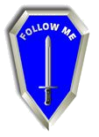

25-mm Equipment Data
(Verbatim)
Misfire: Total failure of a round to fire Hang-fire: Delay in the firing of a round
Cook-off: Accidental firing of a round due to excessive heat build up in the weapon system.

Slide 16
Power Transmission System
25-mm Equipment Data (Verbatim)
1.0 HP 24 Vdc Motor Assembly
Feeder Drive Assembly
Chain and Bolt Drive

Slide 17
Feed Dwell (Verbatim)
Bolt and carrier assembly is 25mm to the rear of Sear, its rearmost position.
The slider moves from left to right in the slider path
The Feeder assembly rotor will rotate 1/3 of a revolution (120 degrees)
This is happening to allow the feeder assembly rotor to sweep the spent casing into the ejection chute and place a new round on the face of the bolt assembly

Slide 18
Fire Dwell (Verbatim)
Bolt assembly is locked in the breech assembly
The slider moves from right to left in the slider path
This is happening to allow hot propellant gases to escape returning chamber pressure to ambient (safe levels)

Slide 19
Ramming/Extracting
(Verbatim)
Positive round control is provided by the:
Positive T-slot extractors
Continuous rim guides

Slide 20
Dual Feed System
(Verbatim)
Link-aligners can move a long round 9.5mm back
Chamfered surface on the rear plate assembly can move a short round 3.1mm forward

Slide 21
Double Feed Prevention
(Verbatim)
The incoming round is positively prevented from feeding across into the ram position; the nose of the incoming round is ahead of the base of the round left in the chamber.
The positive T-slot extractors
Note: Based on M792/M793 ammo. The M791/M910/M919 with missing nose caps may allow a double feed situation to occur!

Slide 22
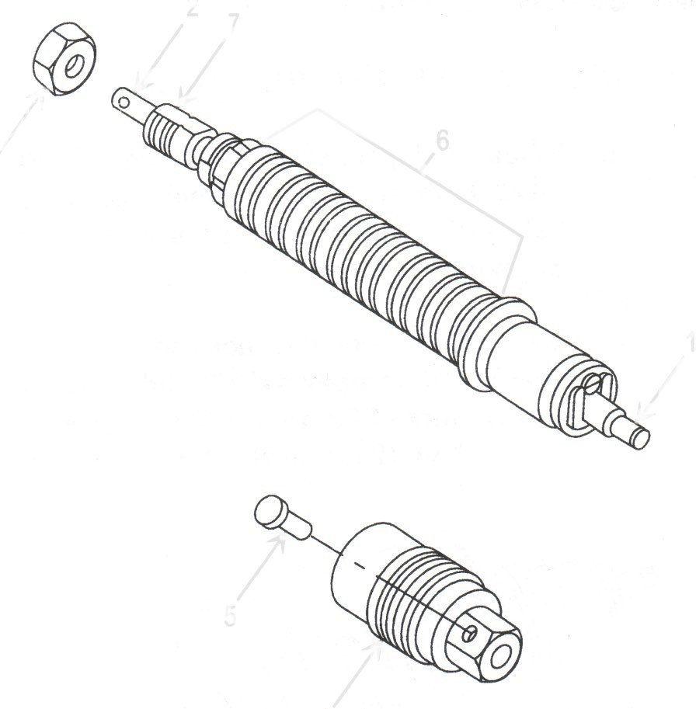
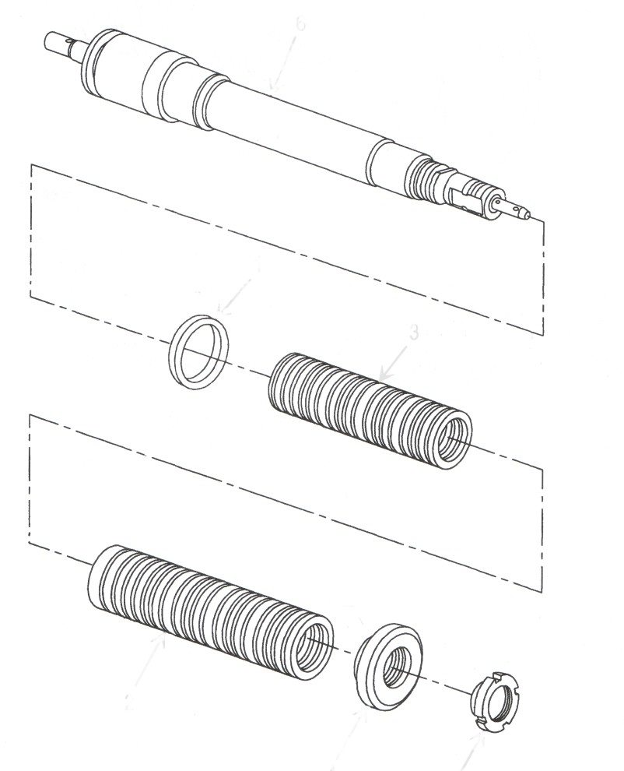
Recoil Mechanism
(Verbatim)
Two ring spring set
Hydraulic Damper
Absorbs 85% of recoil
Remaining 15% absorbed by vehicle
18 Inner (STD)
17 Outer (STD)
17 Inner (ENH)
16 Outer (EHN)

Slide 23
Sear Assembly
(Verbatim)
The primary purpose (function) of the sear assembly is to positively position the roller assembly chain master link, at the end of a firing burst, thereby orienting the gun components for feed selection.
The secondary purpose (Function) of the sear assembly, is to locate receiver assembly components, for proper timing of the feeder and receiver assemblies during assembly.

Slide 24
Mechanical Safety Interlock System
(Verbatim)
6 Components
Rocker assembly
Operating rod assembly
Push Rod Extension
Interlock Crank
Sear push rod
Sear assembly

Slide 25
Mechanical Safety Interlock System Failure Modes
(Verbatim)
Sear Assembly Breaks
Push Rod Extension or Externally Relieved Screw Breaks
Interlock Crank Breaks
Carrier Assembly Cam Breaks
Electrical Sear Solenoid Intermittent

Slide 26
Timing of Power Train
(Verbatim)
Two Timing requirements
Feeder housing disassembled
Feeder assembly removed from receiver assembly

Slide 27
Electrical System
(Verbatim)
Consists of 4 components
1.0 HP 24 VDC Motor assembly
Electrical Sear Solenoid
Electrical Feed Select Solenoid
Index Drive Cable assembly

Slide 28
Index Drive Cable Assembly
(Verbatim)
Electrical Feed Select Solenoid Wiring Harness
Micro Switch Sensor Harness Assembly

Slide 29
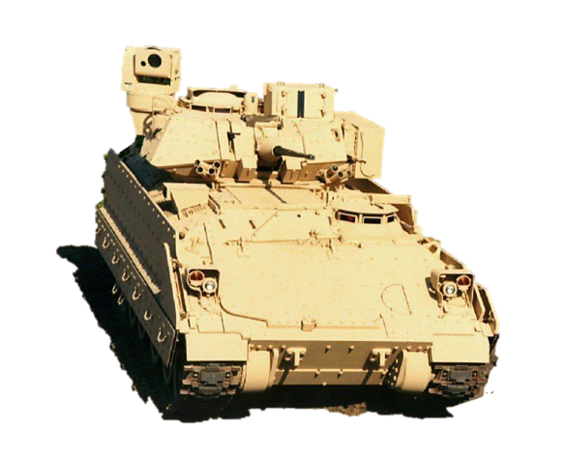
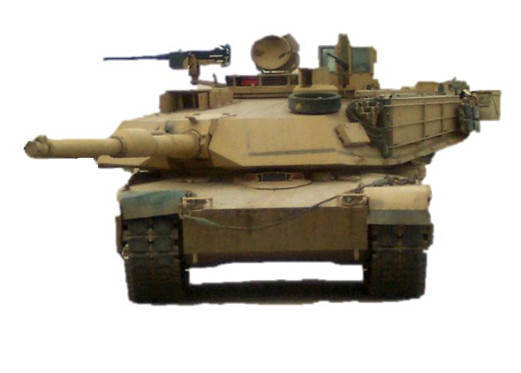

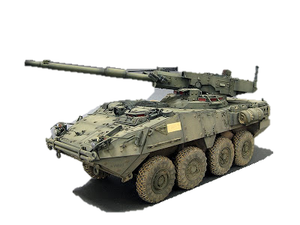
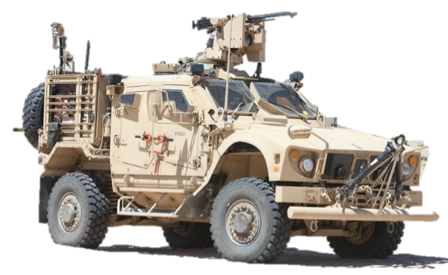

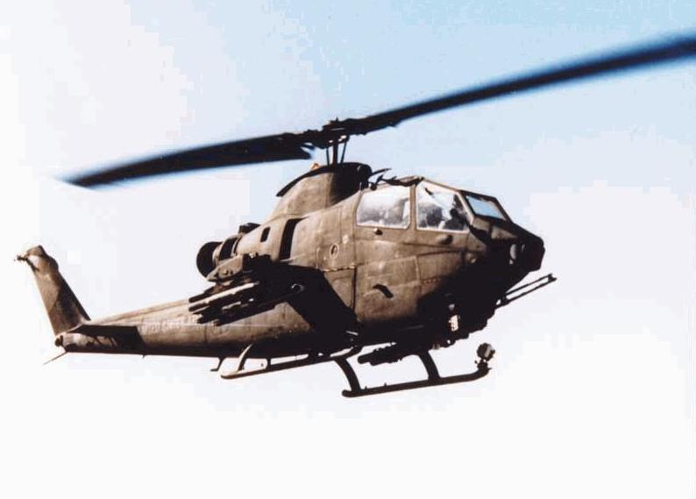
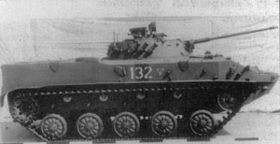
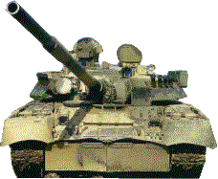
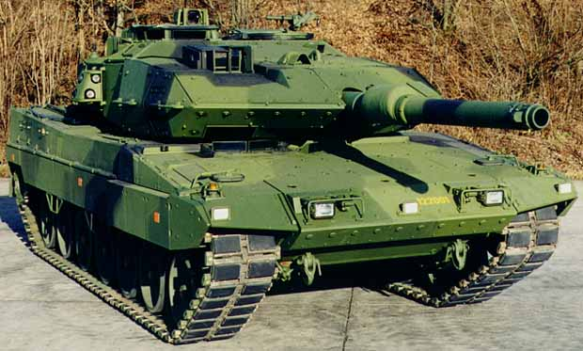
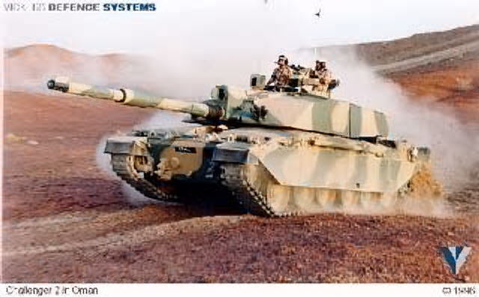
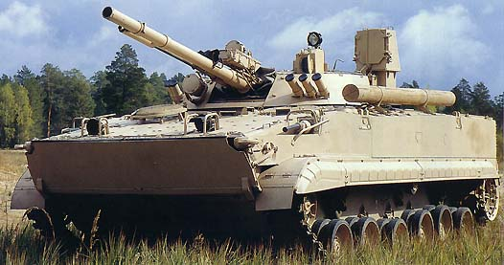
IDENTIFY
Student Study Guide

Slide 30
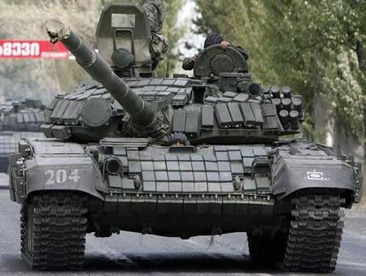
T-72
125mm MER: 3000m
AT-11 Sniper MER: 4000m
Gunner’s night optics
Brick shaped ERA
Grenade launchers on the R/S
Engine exhaust on the L/S
7.62mm Coax
Gunner’s day optics
Single Driver periscope
22 round carousel auto-loader underneath crew compartment of turret

Slide 31
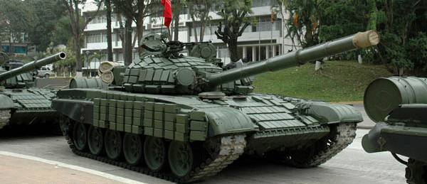
T-72
Vehicle commander on the R/S with 12.7mm MG
Bore evacuator 1/3 away from the end of muzzle
IR search light
No grenade launchers on right side
Extended range fuel tanks
Single driver periscope
Skirts has 4 rows of Brick shaped ERA
Rear sprocket drive and supported track
Brick shaped ERA
6 evenly spaced road wheels

Slide 32
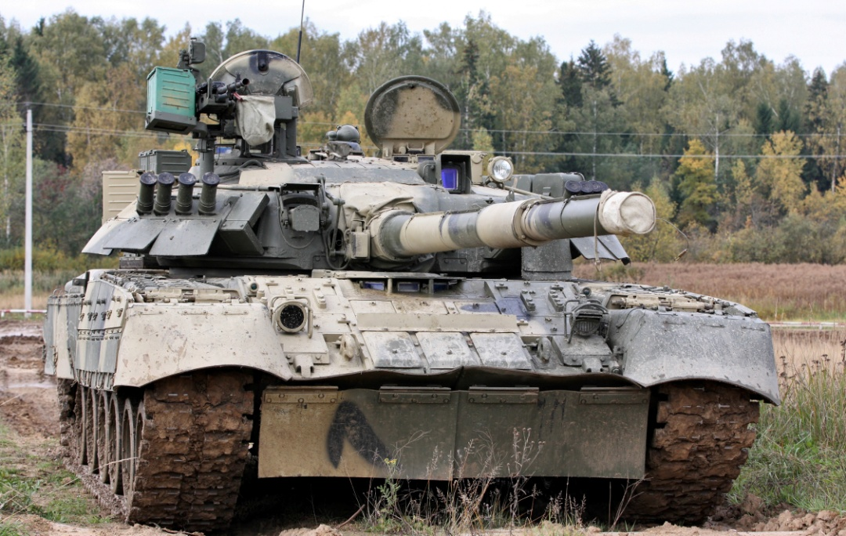
T-80
Vehicle commander on the R/S with 12.7mm MG
Gunner’s night optics behind day optics
4 smoke grenade launchers on both sides
Gunner’s day optics
Add on armor & anti-armor RPG plates to protect turret ring
125mm MER: 3000m
AT-8 Songster MER: 4000m
7.62mm Coax
3 driver periscopes
Add-on armor plates front hull
28 round carousel auto-loader underneath crew compartment of turret

Slide 33
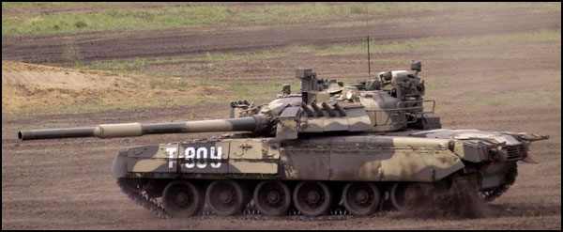
T-80
Anti-armor RPG plates to protect turret ring
125mm gun can fire a radio guided missiles.
Bore evacuator 1/3 from the end of the muzzle.
Gunner’s night optics
Gunner’s day optics
Extended range fuel tank racks
Add-on armor plates on front skirts
Turbine engine exhaust center rear
1 & 2 paired road wheels
3 & 4 paired road wheels
Supported track rear sprocket drive

Slide 34
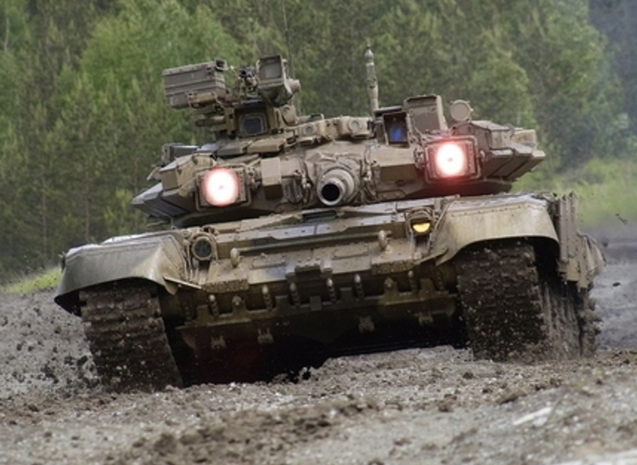
T-90
Vehicle commander on the R/S with 12.7mm MG
Laser warning receivers
Gunner’s night optics
SHTORA optical jammer counter-measure vs. ATGMs
Gunner’s day optics
7.62mm Coax
125mm MER: 3000m
AT-11b Sniper MER: 5000m
Bulldozer blade
V-shaped cut add on armor around driver periscope
22 round carousel auto-loader underneath crew compartment of turret

Slide 35
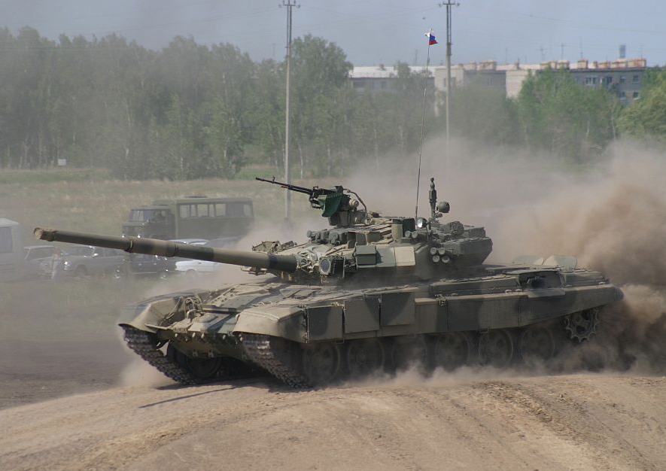
T-90
SHTORA optical jammer counter-measure vs. ATGMs
KONTAKT 5 ERA on front turret shape of a wedge
125mm gun can fire a laser guided missile that can shoot down helicopters
Meteorological data collector
Engine exhaust on the L/S
V-shaped cut add on armor around driver periscope
Rear sprocket drive and supported track
3 segmented add-on armor plates on front skirts
6 evenly spaced road wheels

Slide 36
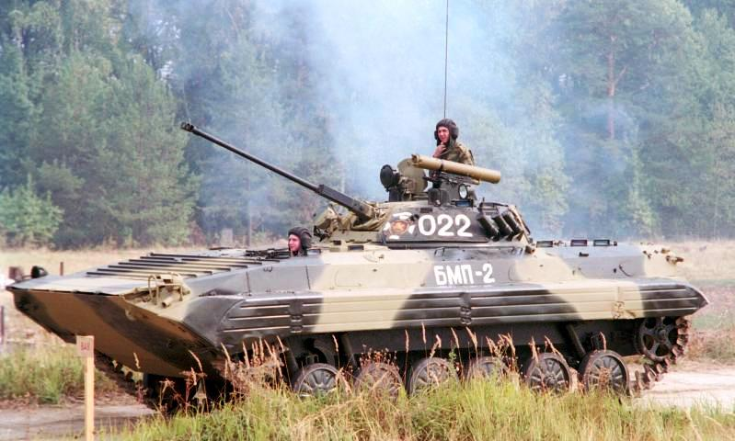
BMP-2
30mm MER: 1500m
AT-5 Spandrel MER: 4000m
Tube launch anti-tank guided missile
Two man larger turret shape of a fry pan
Muzzle break on the end
Troop periscopes for the gun ports
Speed boat shaped hull with trim vane
Bullet deflectors
Front sprocket drive supported track
Top of the track is high in relationship to the hull
Gap between #4, 5, & 6 road wheel

Slide 37
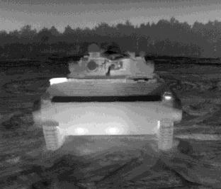
BMP-2
Two man larger wide turret shape of a fry pan
IR search light
30mm MER: 1500m
AT-5 Spandrel MER: 4000m
Engine exhaust
Bullet deflectors
Trim vane
Skinny or thin tracks

Slide 38
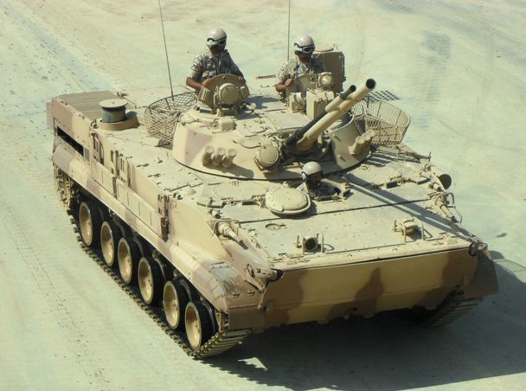
BMP-3
Vehicle commander
Gunner
Two man flat wide turret shape of a fry pan
30mm MER: 2000m
100mm HE & AT-10 Stabber MER: 4000m
Square rear end
Bow gunner hatch & 7.62mm MG
Engine exhaust
Bow gunner hatch & 7.62mm MG
Driver center of hull
Trim vane folds down
6 road wheels that have western style appearance

Slide 39
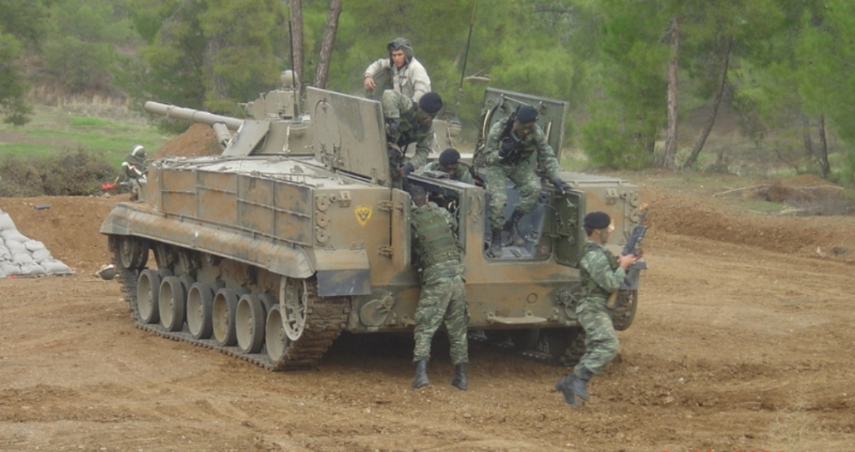
BMP-3
Gunner’s optics
Can carry 6 troops
6 road wheels that have western style appearance
Square rear end
Rear sprocket drive supported track
Hydro propulsion system

Slide 40
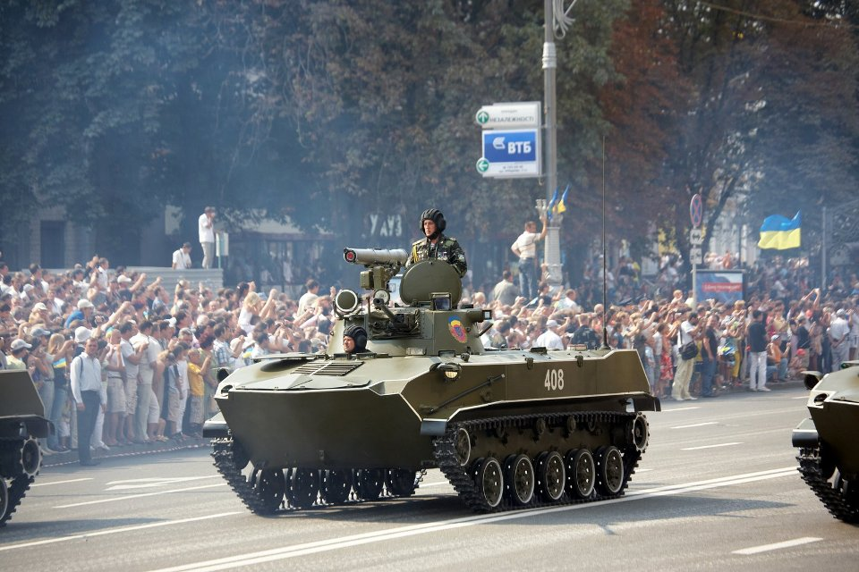
BMD-2
One man small turret for VC/Gunner
30mm MER: 1200m
AT-5 Spandrel MER: 4000m
30mm long skinny gun and tube launch ATGM
Bullet deflectors in front of driver
Sloped rear end
Bow gunner MG port
Rear sprocket drive supported track
5 road wheels that are evenly spaced
4 track support rollers

Slide 41
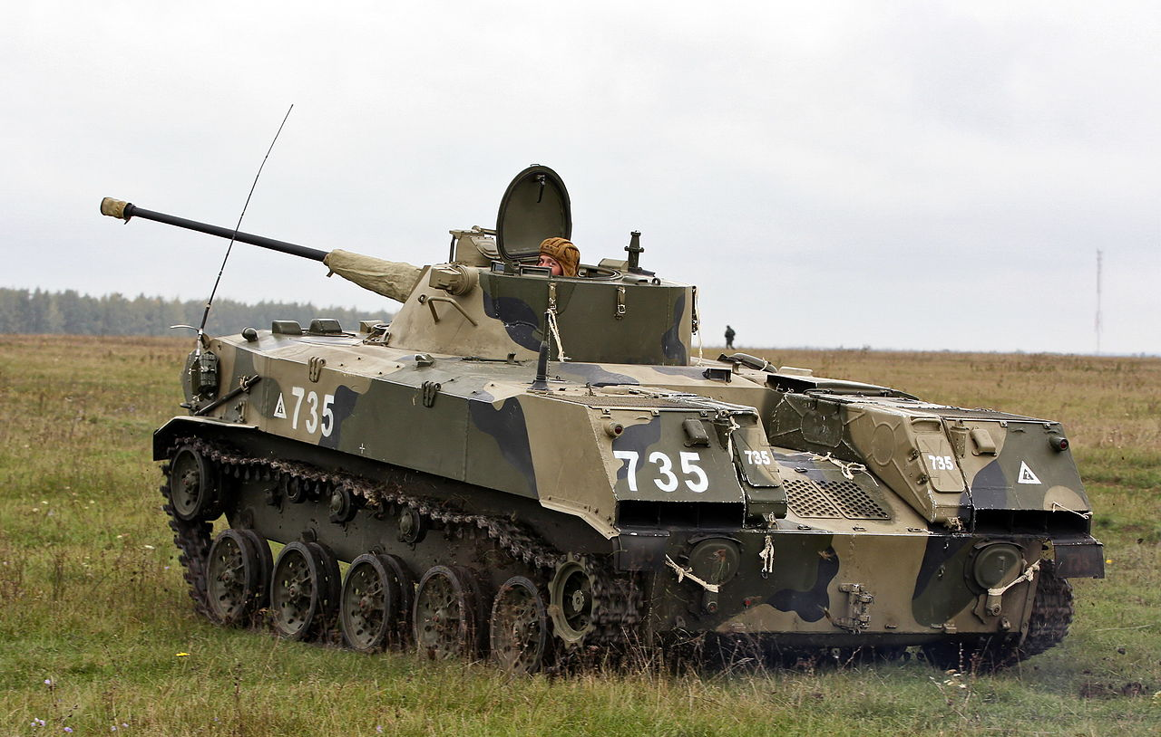
BMD-2
30mm long skinny gun and tube launch ATGM
One man small turret for VC/Gunner
Distinct truck bed appearance in the rear
Muzzle break on the end
Sloped rear end
Engine exhausts
5 road wheels that are evenly spaced
4 track support rollers
Rear sprocket drive supported track
Hydro propulsion system

Slide 42
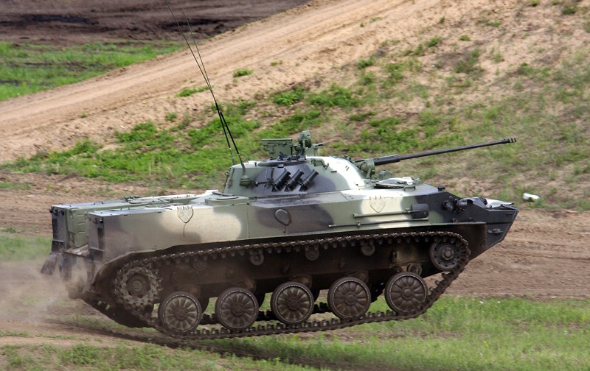
BMD-3
Two man turret with a lower profile
Distinct truck bed appearance in the rear
30mm MER: 1200m
AT-5 Spandrel MER: 4000m
30mm long skinny gun
Squared rear end
Distinct duck bill front slope
Engine exhausts
Rear sprocket drive supported track
4 track support rollers
5 road wheels that look like trash can lids

Slide 43
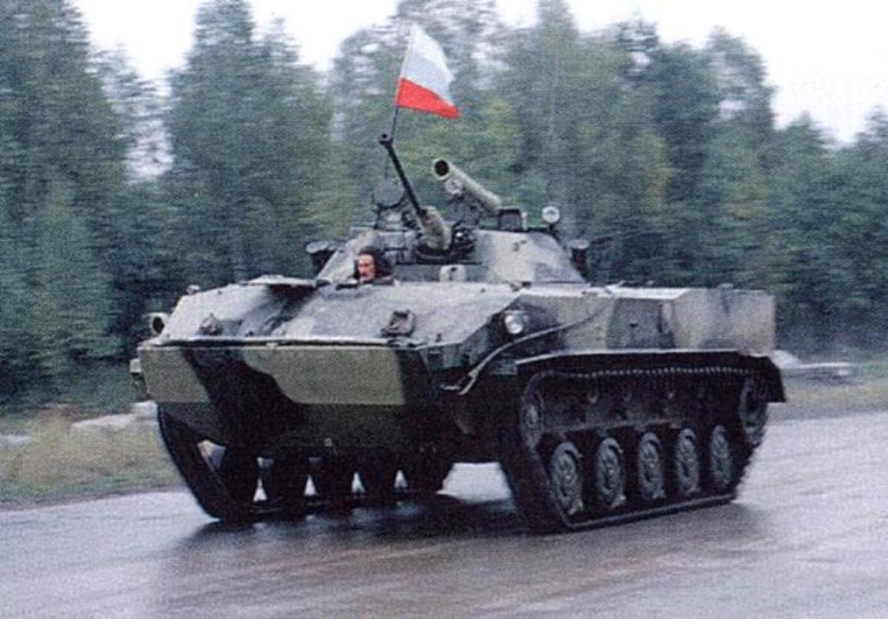
BMD-3
30mm long skinny gun
Two man turret with a lower profile
Tube launch ATGM
Squared rear end
Driver center of hull
Distinct duck bill front slope and it’s straight edge
Rear sprocket drive supported track
Trim vane folds on top
5 road wheels that look like trash can lids
4 track support rollers

Slide 44
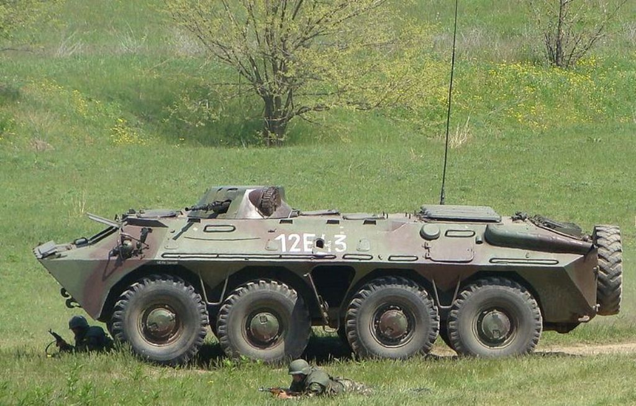
BTR-70
One man turret with no over head hatch
Distinct duck bill front slope and it’s straight edge. Trim vane folds on top
14.5mm
MER: 2000m
Distinct sloped rear-end and exhaust
Troop step up in between #1 & 2 wheels
Troop exit door
Troop step up in between #3 & 4 wheels

Slide 45
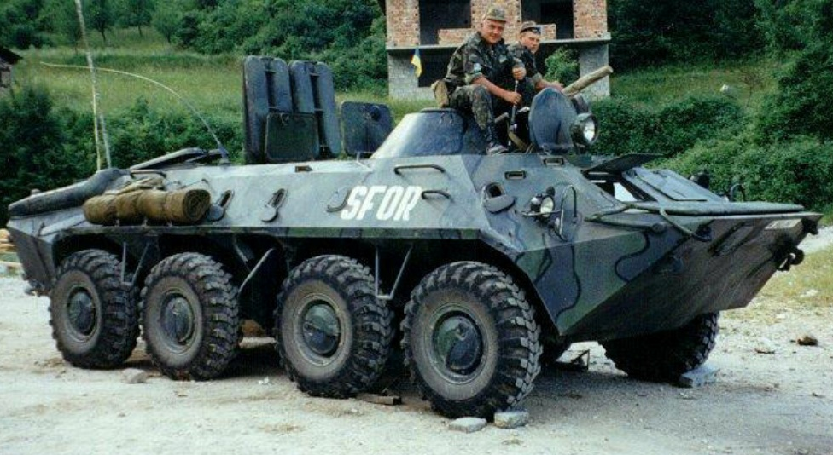
BTR-70
One man turret with no over head hatch
14.5mm MG
Distinct duck bill front slope and it’s straight edge. Trim vane folds on top
Distinct sloped rear-end and exhaust
Twin eyelet windshields
Troop step up in between #3 & 4 wheels
Troop exit door
Troop step up in between #1 & 2 wheels

Slide 46
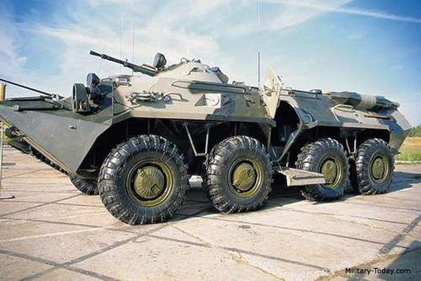
BTR-80
14.5mm
MER: 2000m
One man turret with no over head hatch
Distinct duck bill front slope and it’s straight edge. Trim vane folds on top
Exhaust rear-end is horizontally straight
Troop step up in between #1 & 2 wheels
Troop step up in between #3 & 4 wheels
Improved troop exit doors

Slide 47
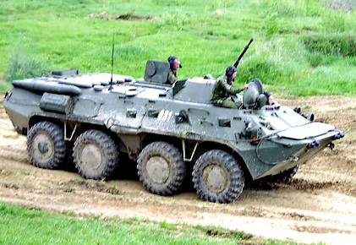
BTR-80
One man turret with no over head hatch
14.5mm MG
Exhaust rear-end is horizontally straight
Twin eyelet windshields
Distinct duck bill front slope and it’s straight edge. Trim vane folds on top
Troop step up in between #3 & 4 wheels
Improved troop exit doors
Troop step up in between #1 & 2 wheels

Slide 48
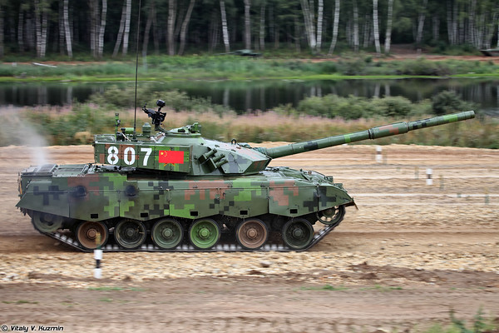
TYPE 96
125mm gun with a bore evacuator 1/3 from the end of the muzzle
Both sides of the turret has 6 smoke grenade launchers
ERA side turret
ERA front glacis
Type 96 only has 2 engine exhausts on the R/S
125mm MER: 3000m
Rear sprocket drive supported track
6 road wheels with gap between #1, 2 & 3

Slide 49
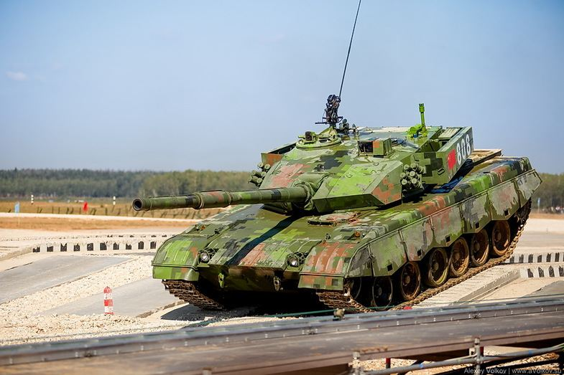
TYPE 96
Gunner optics housing
Meteorological data collector
Vehicle commander’s hatch
Both sides of the turret has 6 smoke grenade launchers
125mm gun with a bore evacuator 1/3 from the end of the muzzle
ERA front glacis
ERA side turret
Utilizes a T-72 design carousel auto-loader
NO engine exhaust on L/S
ERA front slope
6 road wheels with gap between #1, 2 & 3
Driver sits on the L/S of hull

Slide 50
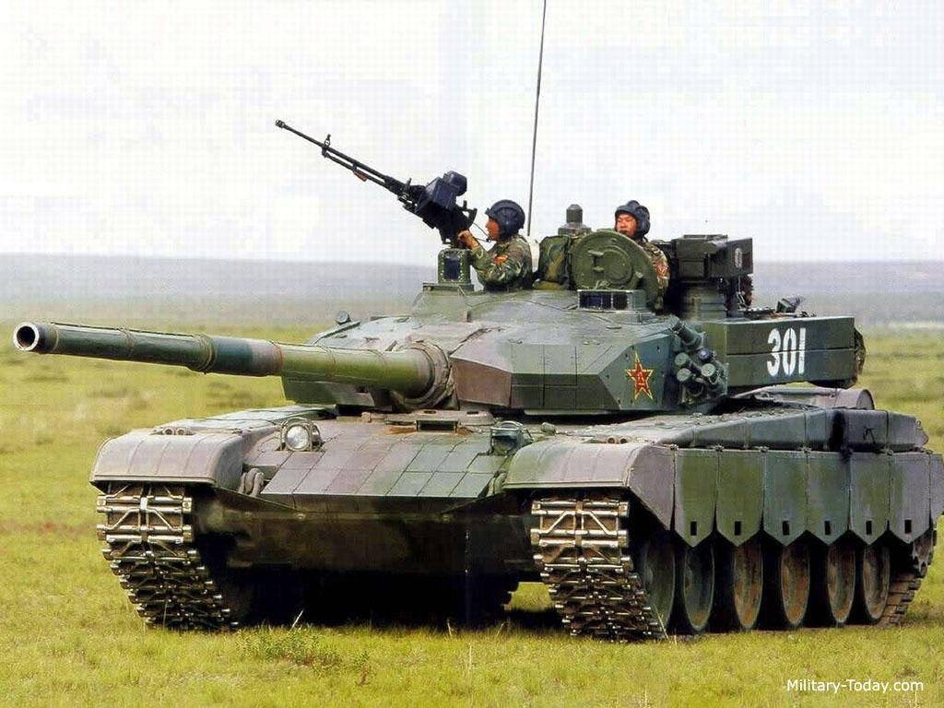
TYPE 99
Gunner optics housing smaller
VC independent optics
Active high powered laser counter-measure vs. missiles
125mm gun with a bore evacuator 1/3 from the end of the muzzle
Both sides of the turret has 5 smoke grenade launchers
Distinct design of ERA on L/S of front glacis. Designed this way for driver exit clearance
ERA side turret
Both sides has 1 engine exhausts
125mm MER: 3000m
AT-11b Sniper MER: 5000m
Utilizes a T-72 design carousel auto-loader
ERA front slope
Driver sits center of the hull with 1 periscope
6 road wheels with #1 & 2 closely paired

Slide 51
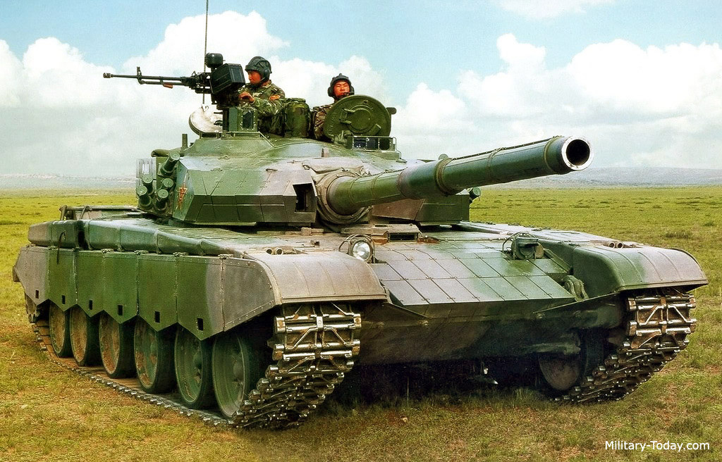
TYPE 99
VC independent optics
Gunner optics housing smaller
Both sides of the turret has 5 smoke grenade launchers
125mm gun with a bore evacuator 1/3 from the end of the muzzle
Both sides has 1 engine exhausts
7.62mm Coax MG
Utilizes a T-72 design carousel auto-loader
Driver sits center of the hull with 1 periscope
6 road wheels with #1 & 2 closely paired
ERA front slope

Slide 52
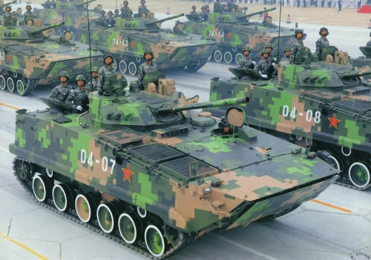
TYPE 97
Vehicle commander
Gunner optics
Two man flat wide turret shape of a fry pan
30mm MER: 2000m
100mm HE & AT-10 Stabber MER: 4000m
Driver center L/S of hull
Engine exhaust
Trim vane folds down
6 road wheels that has a gap between #4, 5, and 6
Front sprocket drive supported track

Slide 53
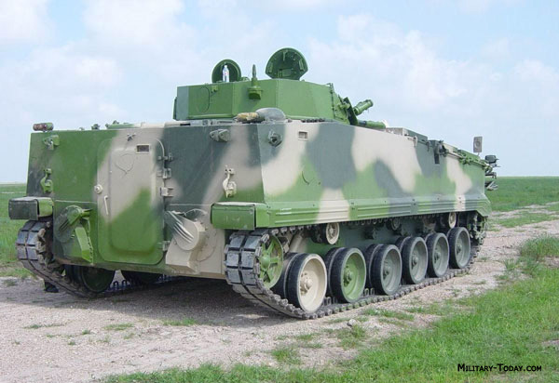
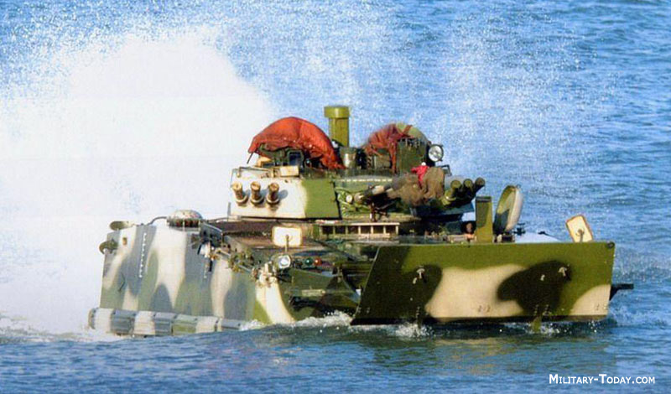
TYPE 97
Troop exit door
Engine exhaust
Front sprocket drive supported track
6 road wheels that has a gap between #4, 5, and 6
Hydro propulsion system
Trim vane Up

Slide 54
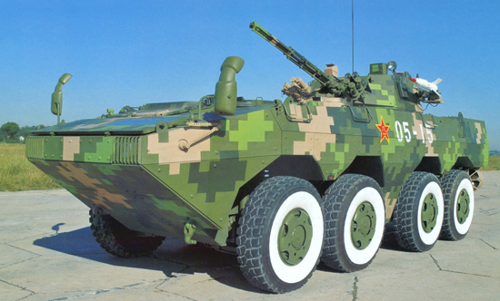
ZBL 09
30mm MER: 2000m
Red Arrow-8 MER: 4000m
Side view mirrors
Speed boat type front hull
Trim vane folds on top
Each wheel has an individual wheel well
Headlights
Distinct hull gap separating the #2 & 3 wheels

Slide 55
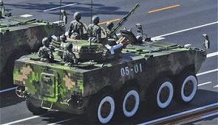
ZBL 09
30mm auto-cannon
Side view mirrors
Driver L/S of hull
Troop exit door
Engine exhaust
Red Arrow-8 ATGM
Propellers for amphibious operations

Slide 56
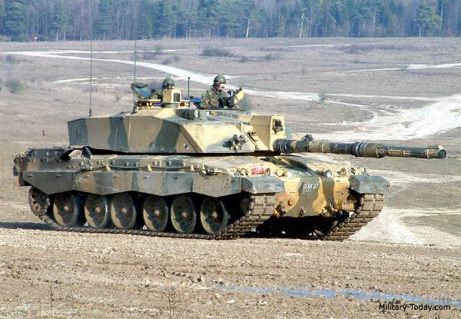
CHALLENGER 2
Sharp angle front armor turret
VC independent viewer
Stowage boxes wrap around back of turret. Vertical side armor
Gunner thermal optics on gun mantle
120mm MER: 4000m
with bore evacuator 1/3 from the end of the muzzle
Engine exhaust on both sides of hull
Rear sprocket drive supported track
Gap between #5 & 6 road with 6 sets of road wheels on both sides
Driver sits center of the hull

Slide 57
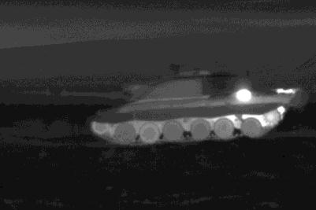
CHALLENGER 2
Sharp angle front armor turret
Stowage boxes wrap around back of turret. Vertical side armor
120mm gun with bore evacuator 1/3 from the end of the muzzle
Gunner thermal optics on gun mantle
Engine exhaust on both sides of hull
Rear sprocket drive supported track
Gap between #5 & 6 road with 6 sets of road wheels on both sides

Slide 58
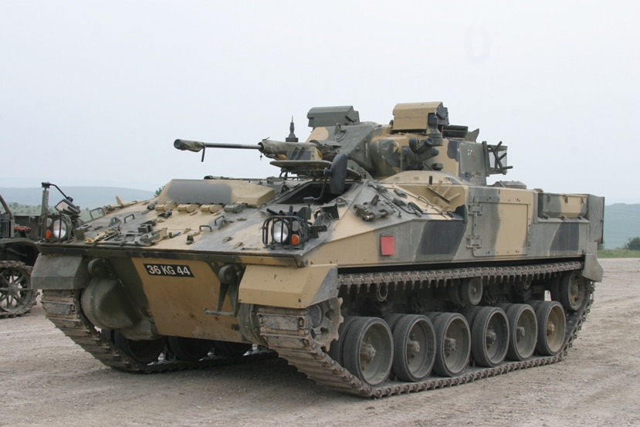
WARRIOR
VC & Gunner optics
Driver L/S of hull
30mm MER: 1500m
Crew escape hatch
Sharp sloped front end
Front sprocket drive supported track
Gap between #3 & 4 road wheels

Slide 59
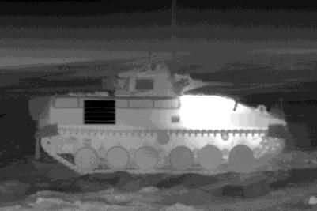
WARRIOR
Engine exhaust R/S
Rear stowage boxes are square
Sharp sloped front end
Combat Identification Panel (CIP)
Front sprocket drive supported track
Gap between #3 & 4 road wheels

Slide 60
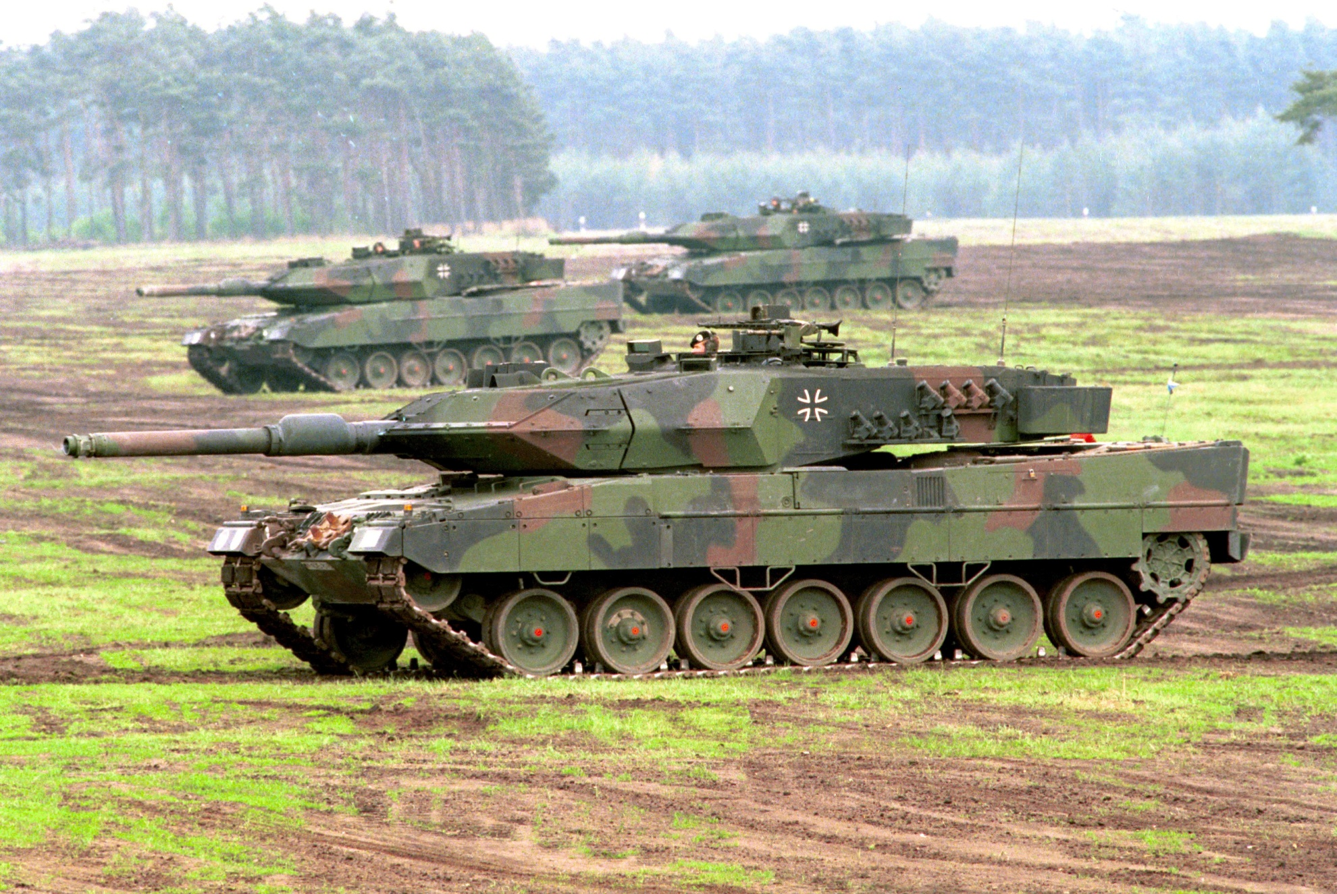
LEOPARD 2
Leo 2A5 wedge shaped front armor
120mm MER: 4000m
with bore evacuator 2/3 from the end of the muzzle
Gunner’s optics housing
Driver’s hatch R/S of hull
7 sets of road wheels evenly spaced
Rear sprocket drive supported track

Slide 61
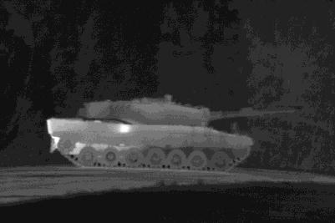
LEOPARD 2
Leo 2A4 flat vertical front armor
120mm gun with bore evacuator 2/3 from the end of the muzzle
Heater exhaust
Rear engine exhaust
Rear sprocket drive supported track
7 sets of road wheels evenly spaced

Slide 62

PUMA
VC independent optronic camera
Gunner optics
Driver L/S of hull
Remote operated turret with 30mm MER: 3000m
Engine exhaust R/S
Sharp sloped front end
Non-amphibious IFV
Gap between #3, 4 & 5 sets road wheels
Front sprocket drive supported track

Slide 63

PUMA
VC independent optronic camera
Remote operated turret with 30mm cannon
Gunner optics
Driver L/S of hull
Drop down troop ramp
Sharp sloped front end
Front sprocket drive supported track
Non-amphibious IFV
Gap between #3, 4 & 5 sets of road wheels

Slide 64

GTK BOXER
Remote operated, can be equipped with .50 cal or Grenade launcher
Modular crew compartment design. It can be removed from the wheel base.
VC hatch
Sharp sloped front end
12.7mm MER: 1800m
40mm MER: 2212m
8x8 wheeled APC distinct hull gap separating the #2 &3 wheels

Slide 65

GTK BOXER
Driver hatch has ballistic windshield when driving open hatch
.50 cal MG manually operated
Modular crew compartment design. It can be removed from the wheel base.
12.7mm MER: 1800m
40mm MER: 2212m
Engine exhaust L/S
Sharp sloped front end
8x8 wheeled APC distinct hull gap separating the #2 &3 wheels

Slide 66

LECLERC
VC L/S of turret with an independent thermal camera
Gunner R/S of turret with his optics
MRS collimator
120mm MER: 3000m
no bore evacuator segmented thermal shrouds
Utilizes an auto-loader
Driver L/S of hull
Rear sprocket drive supported track
6 sets of road wheels evenly spaced
Modular armor, designed to be unbolted and replaced if damaged in combat

Slide 67

LECLERC
120mm gun no bore evacuator segmented thermal shrouds
Gunner R/S of turret with his optics
VC L/S of turret with an independent thermal camera
Utilizes an auto-loader
Engine exhaust L/R
Driver L/S of hull
6 sets of road wheels evenly spaced
Rear sprocket drive supported track
Modular armor, designed to be unbolted and replaced if damaged in combat

Slide 68

VBCI
DRAGAR one man turret that can be placed in automatic air defense mode using
25mm MER: 3000m chain gun
Non-amphibious IFV
Driver hatch positioned on the down slope of the hull L/S
Modular armor designed to be unbolted and replaced if damaged in combat
Rear smoke grenade launchers
VC hatch L/S of hull
8x8 wheeled APC with individual wheel wells for each wheel

Slide 69

VBCI
DRAGAR one man turret that can be placed in automatic air defense mode using 25mm chain gun & 7.62mm coax
Non-amphibious IFV
Modular armor designed to be unbolted and replaced if damaged in combat
VC hatch L/S of hull
Driver hatch positioned on the down slope of the hull L/S
Rear smoke grenade launchers
Engine exhaust
Bottom front end is shaped like a hammerhead shark

Slide 70

K1A1
120mm MER: 4000m
with bore evacuator 2/3 from the end of the muzzle
Vehicle commander on the R/S with an independent viewer
Turret lower silhouette in comparison to an Abrams
Gunner’s optics housing
Smoke grenade launchers mounted in front of turret armor
Rear sprocket drive supported track
Driver’s L/S of the hull
6 sets of road wheels on both sides

Slide 71

K1A1
120mm gun with bore evacuator 2/3 from the end of the muzzle
Vehicle commander on the R/S of the turret
Turret is tapered in the rear comparison to an Abrams
Driver’s L/S of the hull
6 sets of road wheels on both sides #3 & 5 are paired together
2 rear diesel engine exhausts
Rear sprocket drive supported track

Slide 72

K21
Fully amphibious
VC independent viewer
40mm MER: 3000m
Gunner optics
2 ATGM launchers
Sharp sloped front end
Driver L/S of hull
Trim vane folds down from the bottom
6 sets of road wheels evenly spaced
Front sprocket drive supported track

Slide 73

K21
Fully amphibious
VC independent viewer
Gunner optics
40mm auto-cannon with cone muzzle break
Drop down troop ramp door
Driver L/S of hull
Front sprocket drive supported track
6 sets of road wheels evenly spaced

Slide 74

M1A1 ABRAMS
Angular large slab armored turret
120mm MER: 4000m
with bore evacuator 2/3 from the end of the muzzle
Vehicle commander on the R/S with .50 CAL MG
Cylinder smoke grenade launchers indicate this is a Marine Abrams
Gunner’s optics housing
Driver’s hatch center of hull
Rear sprocket drive supported track
Gap between #1 & 2 road with 7 sets of road wheels on both sides

Slide 75
M1A1 ABRAMS
Angular large slab armored turret
Combat Identification Panels (CIP)
Bustle rack and stowage boxes
120mm gun with bore evacuator 2/3 from the end of the muzzle
Turbine rear engine exhaust
Gap between #1 & 2 road with 7 sets of road wheels on both sides
Rear sprocket drive supported track

Slide 76

M2/M3 BRADLEY
VC independent viewer
VC hatch
Gunner’s optics housing
Tow launchers in stowed position on L/S of turret
7.62mm Coax MG
25mm chain gun
Driver’s hatch
Engine exhaust
25mm MER: 2000m
TOW MER: 3750m
Final drive housings

Slide 77

M2/M3 BRADLEY
Gunner’s optics housing
Tow launchers in stowed position on L/S of turret
25mm chain gun
Driver’s hatch
Front sprocket drive supported track
Gap between #3 & 4 road wheels
Combat Identification Panel (CIP)

Slide 78

LAV-25 COYOTE
Gunner’s optics housing
Turret is longer or turret overhang
25mm MER: 2000m
Muffler on R/S of hull only
Driver L/S of hull
Boat shape hull
Trim vane
Propellers on both rear ends of the hull
Long continuous wheel well, no hull partitions

Slide 79

LAV-25 COYOTE
Turret is longer or turret overhang
25mm chain gun
Boat shape hull
Long continuous wheel well, no hull partitions
Propellers on both rear ends of the hull

Slide 80

STRYKER
(M1126 ICV)
.50cal MER: 1800m
MK19 MER: 2212m
Remote Weapon Station (RWS)
VC hatch
Winch
Squad leader hatch
Slat/Bar armor standard feature in Iraq & Afghanistan
Driver L/S of hull
Inner ring in the wheel are troop step rings
No propellers, non-amphibious vehicle
Storage for tire changing equipment

Slide 81

STRYKER
(M1126 ICV)
.50cal MER: 1800m
MK19 MER: 2212m
Remote Weapon Station (RWS)
Slat/Bar armor standard feature in Iraq & Afghanistan
Engine exhaust
No propellers, non-amphibious vehicle
Gap between #2 & 3 wheel

Slide 82

AAV
Off-center from the hull is a one man turret with a dual trunnion axis .50 cal and MK 19
.50cal MER: 1800m
MK19 MER: 2212m
Driver L/S of hull
Trim vane
Enhanced Armor Appliqué Kit (EAAK)

Slide 83

AAV
.50cal MER: 1800m
MK19 MER: 2212m
Off-center from the hull is a one man turret with a dual trunnion axis .50 cal and MK 19
Engine exhaust
Enhanced Armor Appliqué Kit (EAAK)
Both sides of the rear- end have propellers
Front sprocket drive un-supported track
6 sets of road wheels, gap between #3 & 4

Slide 84

M-ATV
Variants shown will have a turret or CROW
Front engine,
rear or 4-wheel drive, 4 passenger, 4 door truck
.50cal MER: 1800m
MK19 MER: 2212m

Slide 85

M-ATV
Variants shown will have a turret or CROW
.50cal MER: 1800m
MK19 MER: 2212m
Front engine,
rear or 4-wheel drive, 4 passenger, 4 door truck

Slide 86

5 main rotor blades
Tail rotor is on the L/S
Bubble shaped tandem pilot canopies
Re-tractable landing gear
MI-24 HIND-D
12.7mm MER: 1500m
AT-2 Swatter 2500m
Swept back wing weapon load mount points

Slide 87

MI-24P HIND-F
Tail rotor is on the L/S
5 main rotor blades
Engine exhausts on both sides
Twin air inlets
Bubble shaped tandem pilot canopies
Tail skid
Large sloped wings to mount missiles & rockets
Mid-air refueling stake
HIND-F has twin 30mm auto-cannons
Re-tractable landing gear

Slide 88

MI-24P HIND-F
Tail rotor is on the L/S
5 main rotor blades
Twin air inlets
Engine exhausts on both sides
Large sloped wings to mount missiles & rockets
Bubble shaped tandem pilot canopies
HIND-F has twin 30mm auto-cannons
Re-tractable landing gear

Slide 89

MI-28 HAVOC
Stabilizer wing
5 main rotor blades
Engine exhausts on both sides of fuselage
Armored angular shaped tandem pilot canopies
Mouse nose radar
Fixed wheeled landing gears
30mm MER: 3000m
AT-6 Spiral MER: 5000m
Under mount 30mm chain gun

Slide 90

MI-28 HAVOC
High accuracy radar navigation system
30mm MER: 3000m
AT-6 Spiral MER: 5000m
Armored angular shaped tandem pilot canopies
Tail rotor is on the R/S
Stabilizer fin
Mouse nose radar
Target sight system
Short sloped wing weapon load mount points
Dual air inlets
Under mount 30mm chain gun
Fixed wheeled landing gears

Slide 91

KA-52 HOKUM-B (Alligator)
Coaxial contra-rotating rotor blades
30mm MER: 3000m
AT-9 Vikhr MER: 10,000m
No tail rotor
Vertical rudder
Engine vector exhausts
2 pilots sits next to each other in the canopy
Weapon load mount wings are straight
Dual air inlets
Large airplane type nose to house the radar system
30mm chain gun mounted on the R/S fuselage
Re-tractable landing gears

Slide 92

KA-52 HOKUM-B (Alligator)
30mm MER: 3000m
AT-9 Vikhr MER: 10,000m
Coaxial contra-rotating rotor blades
No tail rotor
Vertical rudder
Engine exhausts on both sides of fuselage
Stabilizer fins
2 pilots sits next to each other in the canopy
Large airplane type nose to house the radar system
Air inlet
Weapon load mount wings are straight
Re-tractable mid-air refueling stake
Re-tractable landing gears

Slide 93

Z-10
Angular shaped tandem pilot canopies
5 main rotor blades
Tail rotor R/S
Engine exhausts on both sides of fuselage
Target sight system
Stabilizer wings
30mm MER: 3000m
HJ-10 MER: 8000m
Fixed wheeled landing gears
Chin mount 30mm chain gun
Short aerodynamic wing weapon load mount points

Slide 94

Z-10
Tail rotor R/S
5 main rotor blades
Angular shaped tandem pilot canopies
Engine exhausts on both sides of fuselage
30mm MER: 3000m
HJ-10 MER: 8000m
Stabilizer wings
Target sight system
Short aerodynamic wing weapon load mount points
Chin mount 30mm chain gun
Fixed wheeled landing gears

Slide 95

EC-665 TIGER
Mast mounted sight
4 main rotor blades
Tail rotor is on the R/S
Dual engine exhausts
Angular shaped step tandem pilot canopies
30mm MER: 4000m
HOT MER: 4000m
Stabilizer wings
Short sloped wing weapon load mount points
Fixed wheeled landing gears

Slide 96

EC-665 TIGER
30mm MER: 4000m
HOT MER: 4000m
4 main rotor blades
Air inlets
Tail rotor is on the R/S
Target sight system
Dual engine exhausts
Angular shaped step tandem pilot canopies
Chin mounted 30mm chain gun
Short sloped wing weapon load mount points
Stabilizer wings
Fixed wheeled landing gears

Slide 97

AH-64 APACHE
30mm MER: 4000m
Hellfire MER: 8000m
4 Main rotor blades
Engine exhausts
Tail rotor L/S
Air inlets
Tandem pilot cockpit
Target sight system
Synchronized elevator wing
Both sides of fuselage have straight wing weapon load mount points
30mm chain gun
Fixed wheeled landing gears

Slide 98

AH-64 APACHE
30mm MER: 4000m
Hellfire MER: 8000m
4 Main rotor blades
Engine exhausts
Tandem pilot cockpit
Target sight system
30mm chain gun
Fixed wheeled landing gears

Slide 99

AH-1 COBRA
20mm MER: 2000m
Hellfire MER: 8000m
2 or 4 main rotor blades depending on variant
Air inlets
Tail rotor L/S
Tandem cockpit
Engine exhausts
Chin mounted 20mm Gatling gun
Slim fuselage making it faster and harder to hit
Synchronized elevator wing
Fixed landing skids

Slide 100

AH-1 COBRA
20mm MER: 2000m
Hellfire MER: 8000m
2 or 4 main rotor blades depending on variant
Engine exhausts
Tandem cockpit
Fixed landing skids
Chin mounted 20mm Gatling gun

